Slide 1
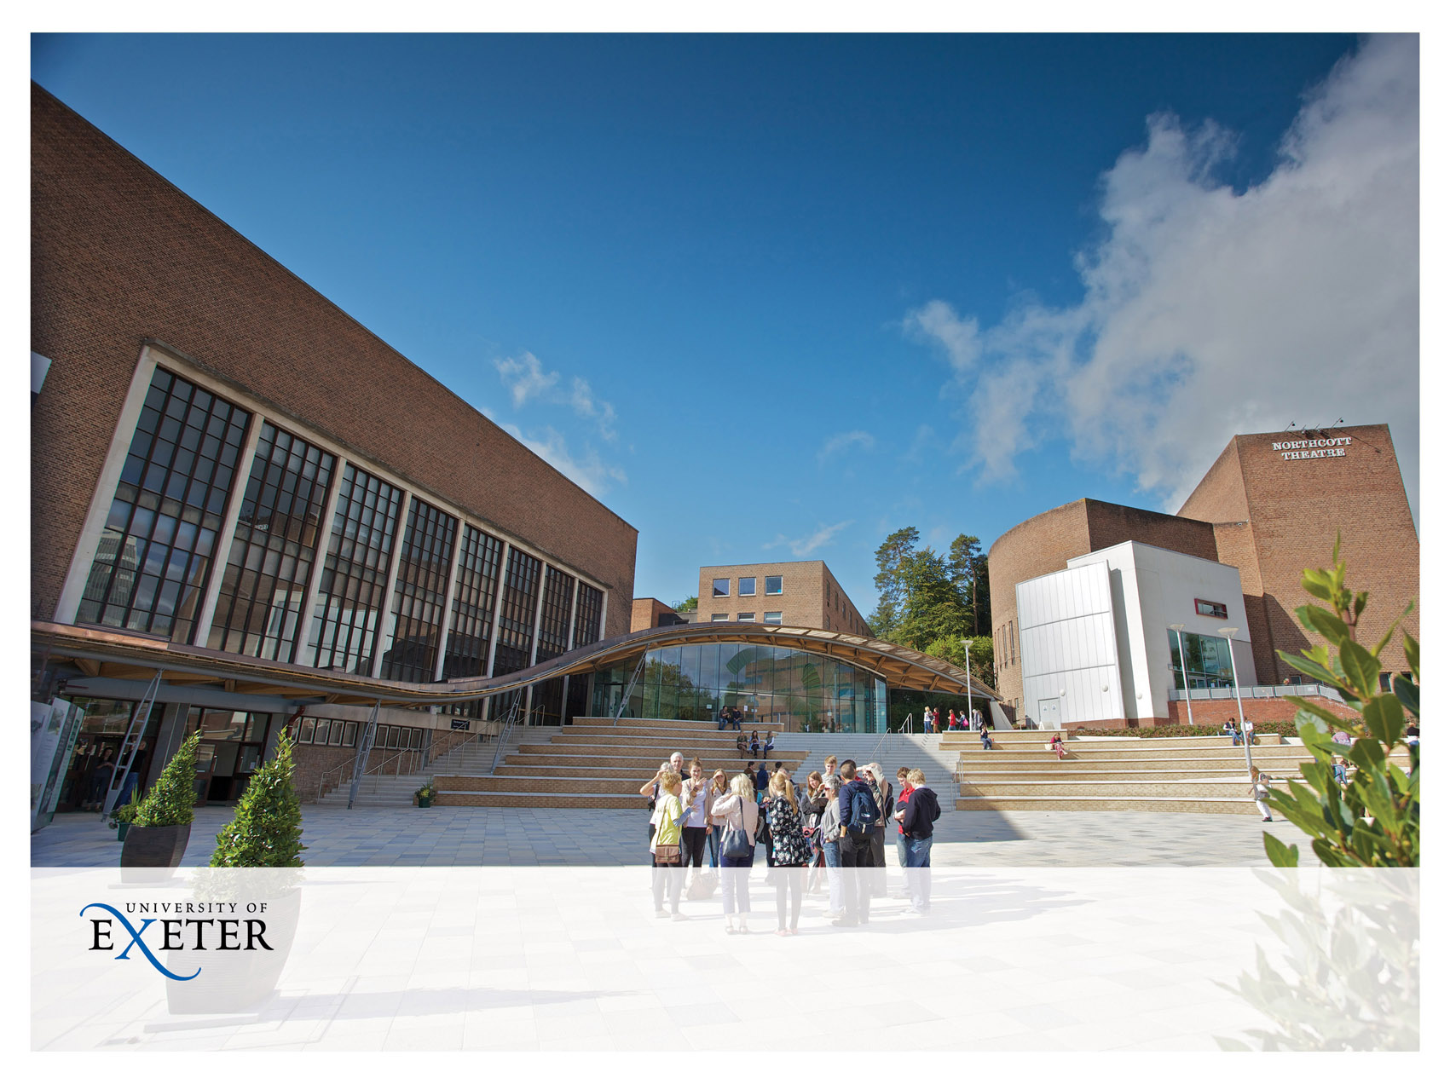
University of Exeter case study – expectation one
Dr Gareth Cole. Data Curation Officer. University of Exeter

Slide 2

Expectation one
Research organisations will promote internal awareness of these principles and expectations and ensure that their researchers and research students have a general awareness of the regulatory environment and of the available exemptions which may be used, should the need arise, to justify the withholding of research data

Slide 3

Promoting internal awareness – to whom
Researchers (65 current EPSRC projects)
PGRs
College Professional Services staff
Central Professional Services staff

Slide 4

Promoting internal awareness – how?
Training sessions on established programmes
Researcher Development Programme
Doctoral Supervisor Course
Information online
Website
Blog – e.g. post on EPSRC
Ad hoc training/information sessions
Drop in sessions
Meetings with relevant Research Office and College staff (most of our EPSRC money is within one academic college)

Slide 5

Promoting internal awareness – new projects
Email sent to new funded projects about open access requirements (RCUK and Wellcome: inc. need for statement on underlying research materials)
For EPSRC projects additional information included about data expectations

Slide 6

Main lessons/advice
Use existing lines of communication where possible.
Recipients read/trust comms they are used to more than a one off email from someone they don’t know.
Ensure support from senior management.
No one medium will reach every researcher.
Emails are good but some recipients can receive 100s a day.
Flyers/posters have some effect – if only to raise questions.
No one team can do all the advocacy necessary.
Recipients don’t always read email.
Also use informal routes of communication.
People change jobs – don’t assume the knowledge stays with the post.
Can there be too much advocacy?
Do recipients start to “tune out” and miss important updates.
Work with your contacts and take their advice on communicating with the target audience.
Face to face sessions work best to get more complex information across.
Work with existing experts at the/your research organisation.
Don’t assume knowledge.

Slide 7

Questions
Contact us:
rdm@exeter.ac.uk
Website: http://as.exeter.ac.uk/library/resources/rdm/

